Slide 1
SGNN
Java – spark – hibernate

Slide 2
Why we pick it?
We both liked the news

Slide 3
Project Spec – MVP
What's Goin' On News have asked you to build a web application to allow them to upload the latest Scottish news.
They want to be able to:
Add, Edit and Remove Journalists
Add, Edit and Remove Articles
For the front end of the website, users should be able to:
View a list of articles, ordered by date. (Newest first!)
Click through to the full story
(Each Article might have a headline, summary paragraph, and the full story - and any other fields you want to add.)

Slide 4
Project Spec – EXTENSIONs
Project Extensions
Search for articles where the title includes a particular search term
Filter articles by journalist
Filter articles by category, which can be added by SGNN
Track how many times an article has been read, and display a list of most popular articles
Paginate your article list - display a certain number of articles per page, with a page number, and navigation to go to the next and previous page

Slide 5
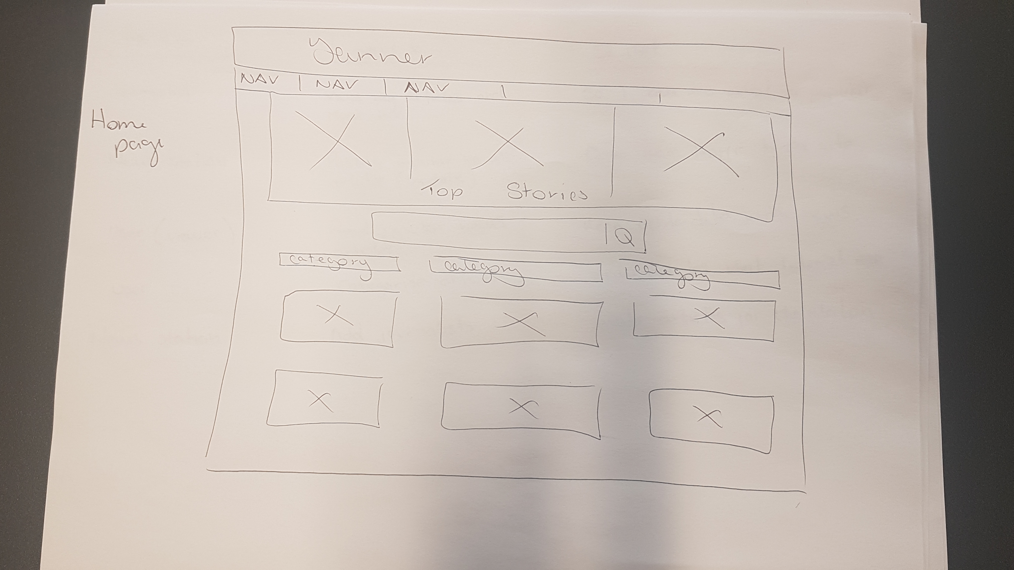
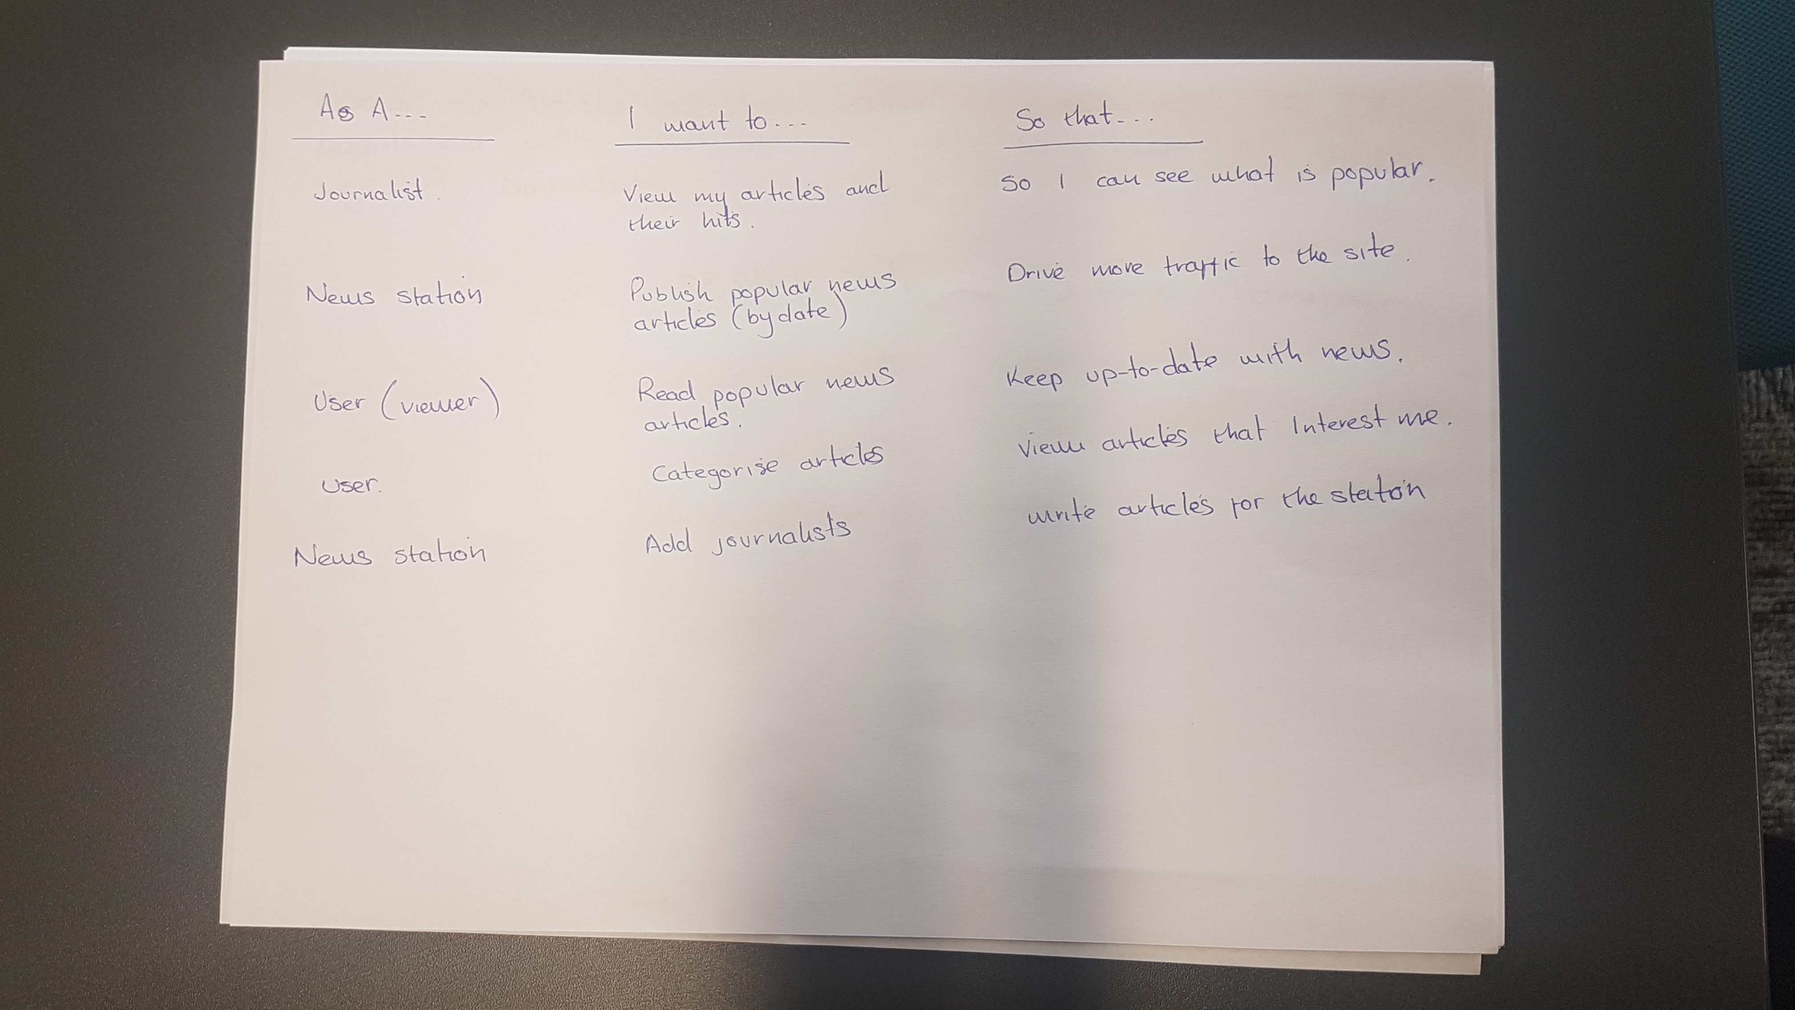
Planning

Slide 6
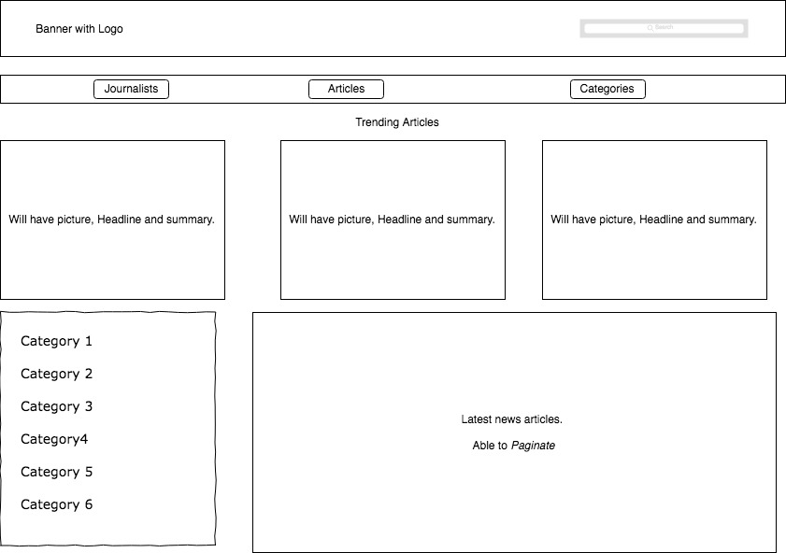
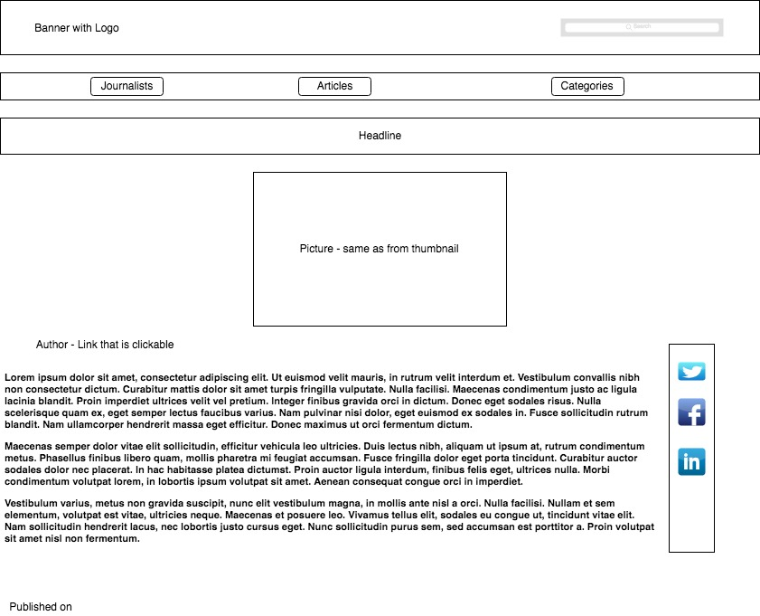
Planning - wireframes

Slide 7
DEMO

Slide 8
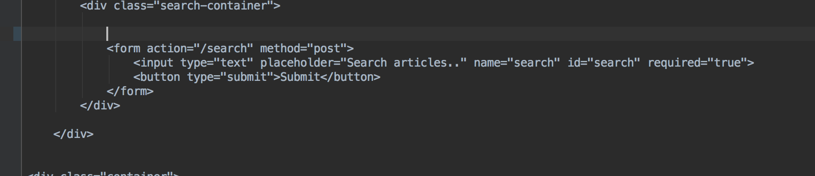
Code we are proud of

Slide 9
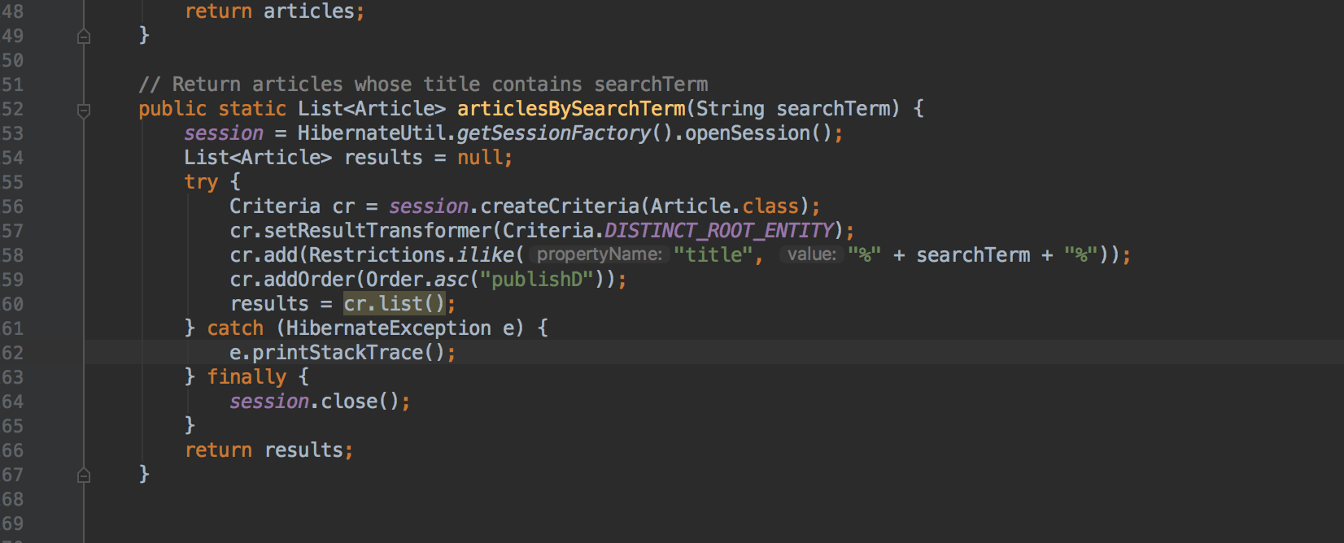
Code we are proud of
DEMO

Slide 10
Things we would change
Work out how to do the pagination – this stumped me

